Slide 1

Transferring Your Data

Slide 2
Brandon Reyes
email: brre2566@colorado.edu
RC Homepage: https://www.colorado.edu/rc
Slides available on GitHub:
Summer_Camp_2023/Day_Two/Transferring_your_data/slides

Slide 3
Outline
Ways to access your data
Data transfer using the command line
Data transfer using Open OnDemand
Data transfer using Globus
Sharing Data
Getting A Petalibrary Allocation

Slide 4
Accessing Data on RC Resources
When you use RC resources the data is not on your local machine
Ways to access the data from your local machine
Command line (a variety of tools)
Open OnDemand (straightforward GUI interface)
Globus (GUI interface with some set up required)

Slide 5
Access through the Command Line
If you don’t need a fancy GUI
Provides a larger variety of tools
SCP
SFTP
RSYNV
RCLONE
SSHFS
SMB
The tools provided can improve your data workflow (more on this later)

Slide 6
General Filesystem Structure
/home (2GB) | /projects (250GB) | /scratch/alpine (10TB)
Small important data Backed up frequently Not for sharing files or job output | Medium sized important data Software Can be shared with others Backed up, but less frequently Not for job output | Large data Can be shared with others Fast Data transfer to compute nodes Not backed up! Purged after 90 days!
Filesystem documentation: https://curc.readthedocs.io/en/latest/compute/filesystems.html

Slide 7
Let’s get on a login node!
ssh <your-username>@login.rc.colorado.edu

Slide 8
RC Filesystem Map
/
/home
/projects
/scratch
/pl
/your-username
/your-username
/alpine
/active
/archive
/your-username
/your-pl-allocation
/your-pl-allocation
You start here!

Slide 9
Basic Navigation Commands
Change directories
List contents of a directory
Print current working directory
cd <relative-or-full-path>
ls <optional-path>
pwd

Slide 10
RC endpoints
Endpoint – one of the two file transfer locations i.e., it is either the source or the destination we want to copy data from or to.
For data on RC resources, we have two endpoints
The login* nodes
Only use for small transfers!!
Data transfer nodes (DTNs)
CSU
<your-username>@login.rc.colorado.edu
<your-username>@dtn.rc.int.colorado.edu
<your-username>@dtn.rc.colorado.edu

Slide 11
RC Data transfer nodes (DTNs)
Command line use of DTNs only available if you are on CU Boulder or CSU’s network or VPN
Dedicated nodes for transferring data
Faster transfers
More stable transfers
Suitable for
Large and frequent transfers
Automated (passwordless) transfers
Only for CU Boulder folks
Cannot ssh into the DTNs!

Slide 12
Command line option - SCP
SCP (Secure Copy Protocol) is a command line tool to transfer files/directories to, from, or between remote locations.
Simple, but useful!
Copying a local file to RC resources using a login node:
Copying a directory from RC resources to local path via a DTN:
scp file1 <username>@login.rc.colorado.edu:<remote-path>
scp –r <username>@dtn.rc.int.colorado.edu:<path-to-directory> <local-path>

Slide 13
Command line option - SFTP
SFTP (Secure File Transfer Protocol) a command line tool that is similar to SCP, but provides an sftp session where both the local and remote filesystems are available
Slightly more advanced than SCP
Useful for multiple file/directory transfers
Starting a SFTP session on a local machine
Demo time!
sftp <username>@login.rc.colorado.edu

Slide 14
Command line options (2)
rsync
rsync is a popular Linux utility for updating changed files to a remote filesystem.
Useful when working on a file on both remote and local machines with modifications that need to be updated
Flags:
-v # verbose mode
-r # recursive (directory)
-t # sync based off timestamp
-c # sync changed files based on content
-a # archive mode
rsync -v file1 <username>@login.rc.colorado.edu:<remote-path>

Slide 15
Command line options (3)
rclone
rclone is a command line program to manage files on cloud storage. It is a feature rich alternative to cloud vendors’ web storage interfaces. Over 40 cloud storage products support rclone including S3 object stores, business & consumer file storage services, as well as standard transfer protocols. Rclone has powerful cloud equivalents to the unix commands rsync, cp, mv, mount, ls, ncdu, tree, rm, and cat.
https://curc.readthedocs.io/en/latest/compute/data-transfer.html#rclone
rclone copy rclonetest.csv aws_s3:testbucket/

Slide 16
Command line options (4)
sshfs
Mount a remote directory to a local Unix operating system!
Mac and Linux Exclusive:
SMB mounting
Universal mounting protocol that is built into every operating system
Contact RC to get this set up!
sshfs <username>@login.rc.colorado.edu:<path> <local-mountpoint>

Slide 17

OpenOnDemand
GUI approach to RC Resources!
http://ondemand.rc.colorado.edu/
File management
Create, Delete, Move, and Rename
File transfers
Upload and Download
Good for managing your files and conducting small file transfers without interacting with a command line.

Slide 18
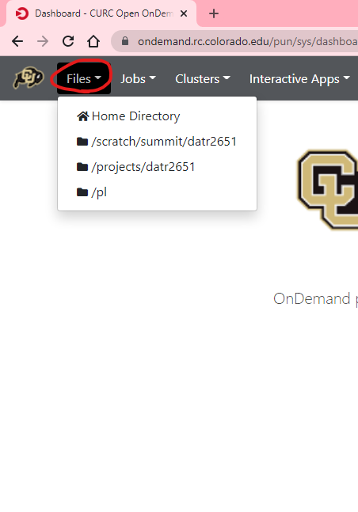
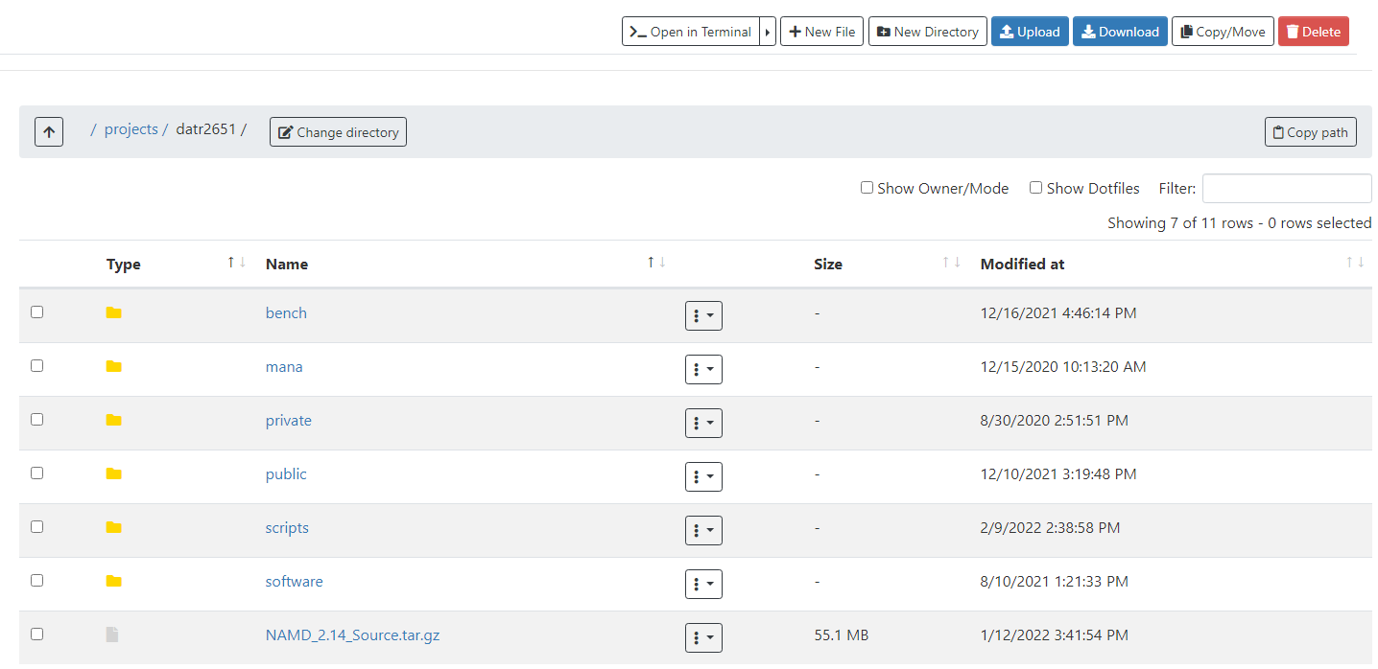

Slide 19

Globus
Globus
By far the most stable and recommended way for data transfers
Fast transfers
Transfers continue if a user disconnects
Web GUI option or Globus Connect Personal
Demo:

Slide 20
Globus Demo (1)
Globus login is simple and quick: https://app.globus.org
Select University of Colorado at Boulder under the dropdown menu
Login with your CU credentials
Continue with onscreen prompts until you are brought to the Globus WebGUI
Installing a Globus Endpoint on your local machine
Navigate down to Endpoints on the sidebar
Click create an endpoint on the top right of the page
Select your operating system and download the installer
Follow the prompts on the installer and complete the installation

Slide 21
Globus Demo (2)
Transferring Files can be done through the GUI
From the File Manager tab:
Click the “Two Panel” view button at the top right.
Click the top left Search bar.
Search “CU Boulder Research Computing” and select the end point.
Sign into Research Computing’s Endpoint
Click the right search bar
On the ‘Your Collections’ tab, choose the endpoint you created
Transfer your files!

Slide 22
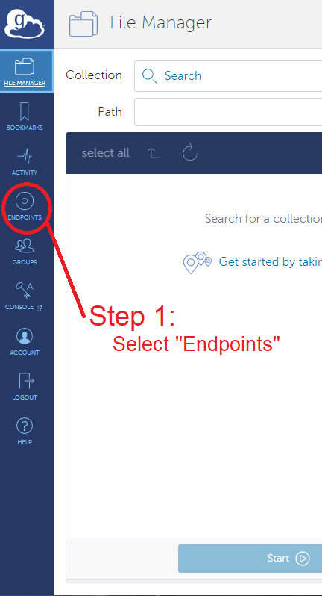
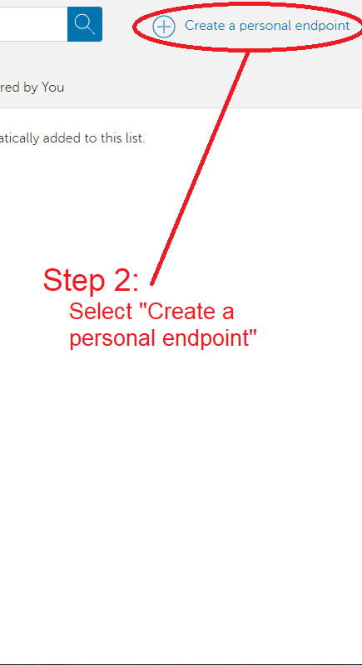
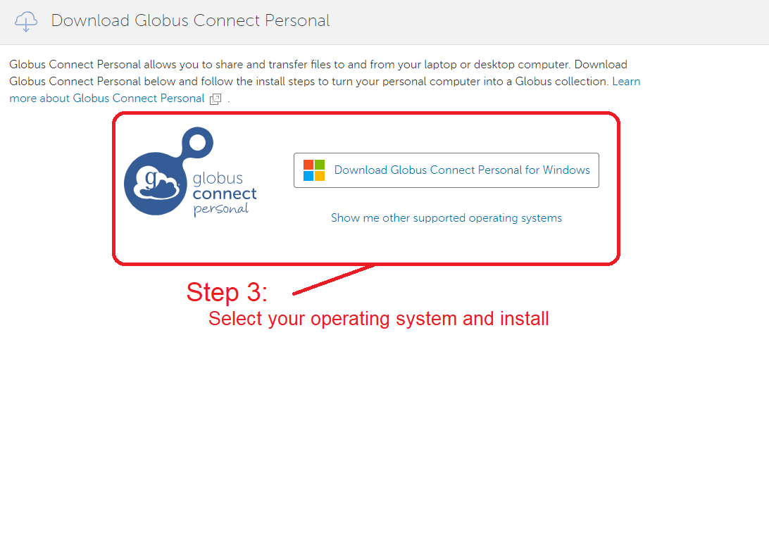

Slide 23
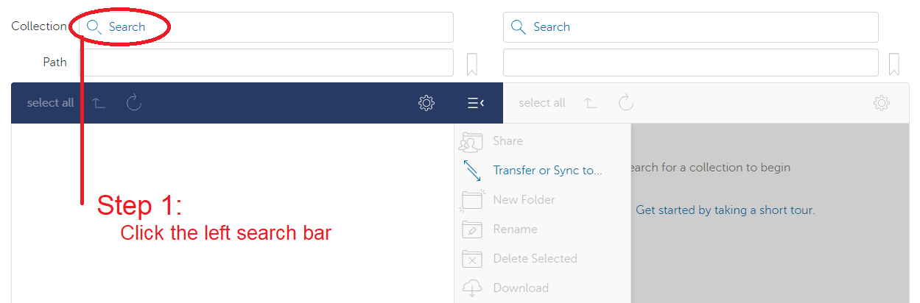
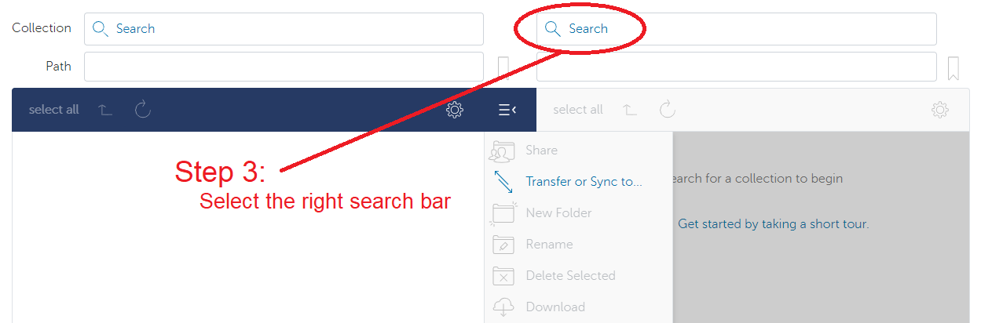
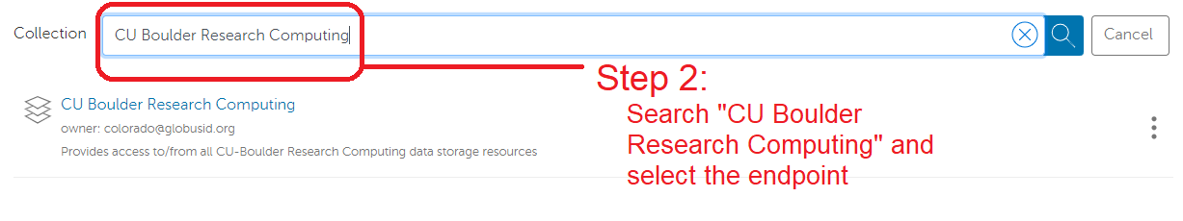
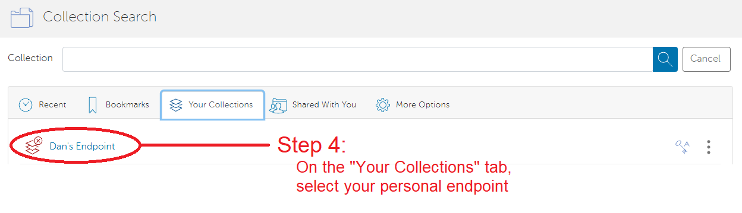

Slide 24
Sharing Data
Other RC Users
To share files that you own with other RC users, contact RC with a list of users you would wish to allow access
RC will place the chosen users in the owner’s group
The owner can then set up permissions in the space
On-premise collaborators can also access Petalibrary files with Globus Shared Endpoints
Off-premise collaborators
Off-premise collaborators can only access Petalibrary files through Globus Shared Endpoints

Slide 25
Unix Groups
Unix Groups
3 Levels of permissions:
User
Group
Other
All users have a group associated with their username
Permissions can be set for an individual file with the chmod command
chmod g+rx file.exe

Slide 26
Globus Shared Endpoints
Globus offers ‘shared endpoints’ which don’t require a user to have an account with RC.
RC provides this capability for easy access of Data.
Petalibrary exclusive!
Generates a shared collection that can be accessed with a link.
Can assign various permissions to specific users or all users withing Globus
More information on here: https://docs.globus.org/how-to/share-files/

Slide 27
Data Publishing with Petalibrary
Using Globus shared endpoints can be a great way to publish your data while maintaining the convenience of having it Petalibrary.
Example: https://scholar.colorado.edu/concern/datasets/9593tw13k

Slide 28
Petalibrary Notes
curc-quota – Research Computing tool to monitor disk usage.
Provides detailed summary of your core storage
Provides detailed summary of scratch space on compile and compute nodes
Also lists current capacity of all Petalibrary allocations you have access to
.cstats- usage statistics file for an allocation
cat /pl/active/<allocation_name>/.cstats
cat /pl/active/rcops/.cstats
Note: Confidential Data is unsupported and should not be stored on Petalibrary!
[userXXXX@login12 ~]$ curc-quota

Slide 29
Thank you!
Please fill out the survey:
Contact information: rc-help@colorado.edu

